Slide 1
Applications of Machine Learning in DOTA2: Literature Review and Practical Knowledge Sharing
Daniil Yashkov, Peter Romov, Kirill Neklyudov,
Aleksander Semenov and Daniil Kireev
Notes:
Hello everybody! My name is Daniil Yashkov and today I’ll tell you about our experience in Data Science in Dota 2 also known as Dota Science. But firstly I’ll tell a bit about machine learning in cybersport

Slide 2
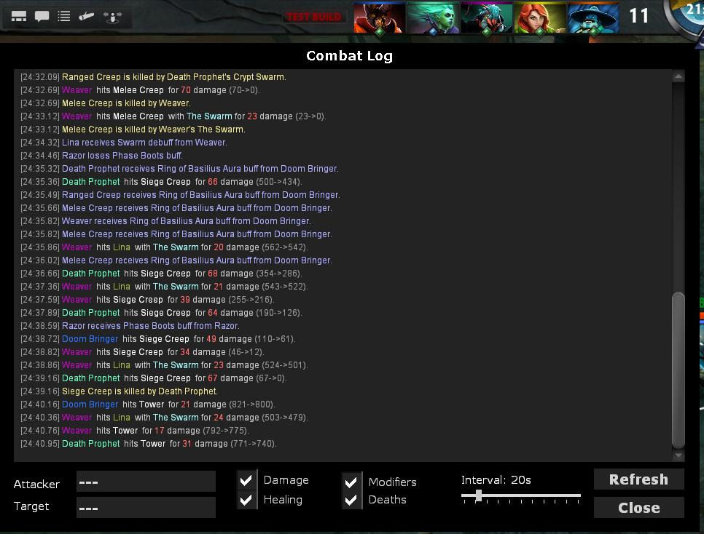
ML for E-Sport
Huge amount of data, collected automatically every day
Data is clean
It is a rapidly growing industry
Over $150 million market
Notes:
Why Cybersport you can ask, because of its data!
enormous amount of it,
it’s clean, because collected automatically
Of course because it’s a growing industry and there are a lot of unresolved problems yet.
Now let’s turn to the particular game – Dota 2

Slide 3
Multiplayer Online Battle Arena (MOBA): Dota 2
2 teams, each one formed of 5 players
1st stage – draft stage :
players from every team choose their heroes
2nd stage – each team is aimed at destroying “Ancient” building of the enemy
During the game each player improve their heroes, gaining gold, experience, killing enemies, buying items, etc.
All this data is logging and collecting.
Notes:
Dota is one of the first games of Multiplayer online battle arena genre. How many of you heard about Dota ? Who know the rules?
That’s nice. So, Dota is a game where two teams, each one consisting of 5 players try to beat each other. There are some stage during the game: first – each player choose a hero, second one – they fight, they aimed at destroying “Ancient” building of the enemy. During the 2nd stage all players gain xp, gold, improving their heroes, in order to kill the enemie’s ancient
As you understand all this data is collected.

Slide 4
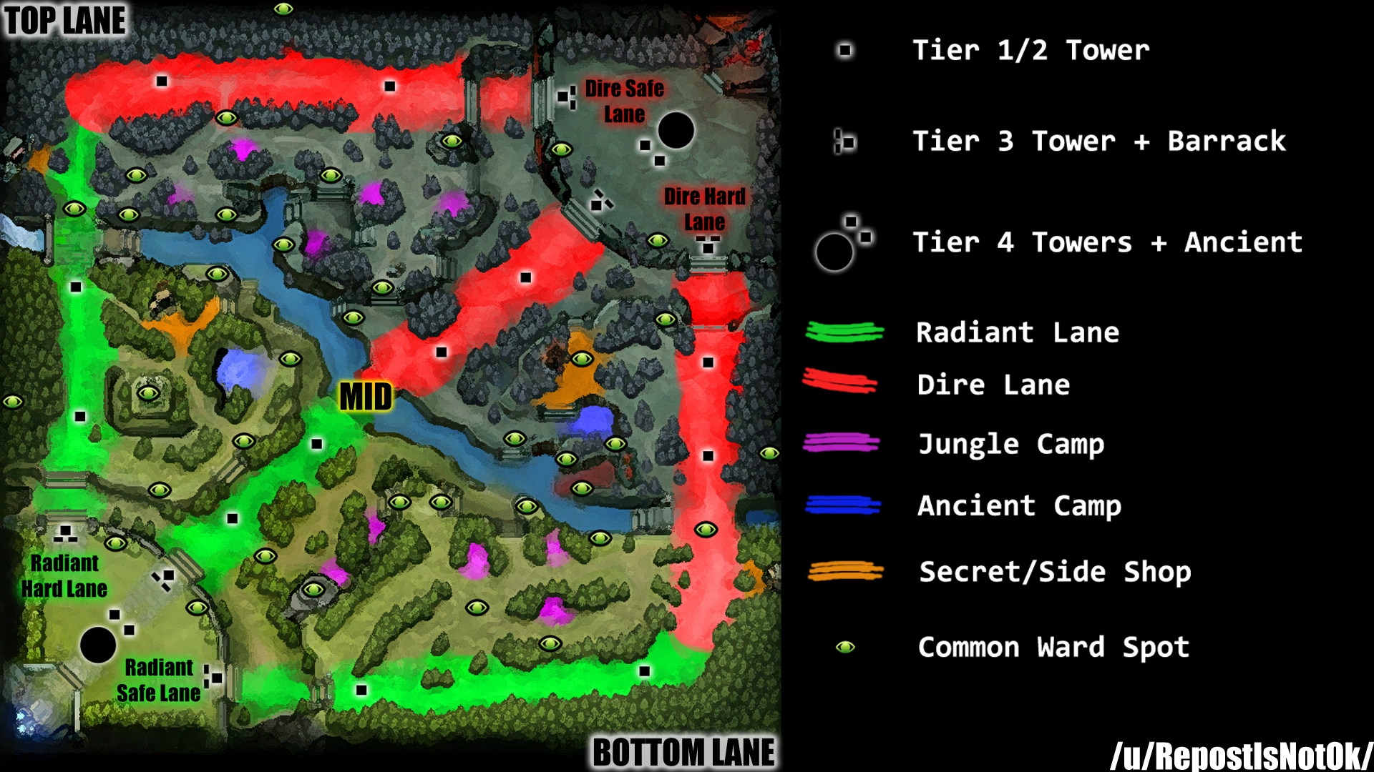
Multiplayer Online Battle Arena (MOBA): Dota 2
Notes:
This is how minimap looks like (where they play). Here are ancients of each team, and here are lanes, towers

Slide 5
Data analysis in Dota 2
Win prediction :
at the start of the game
after draft stage
real-time
Actions/strategies recommendations for players
Player ranking
Smart camera for commentators
…
Notes:
!! Добавить задачу Поиска аккаунтов, которыми играет один и тот же человек (мультинг, если не ошибаюсь) Эту задачу решал Мехри (потешит его самолюбие)

Slide 6
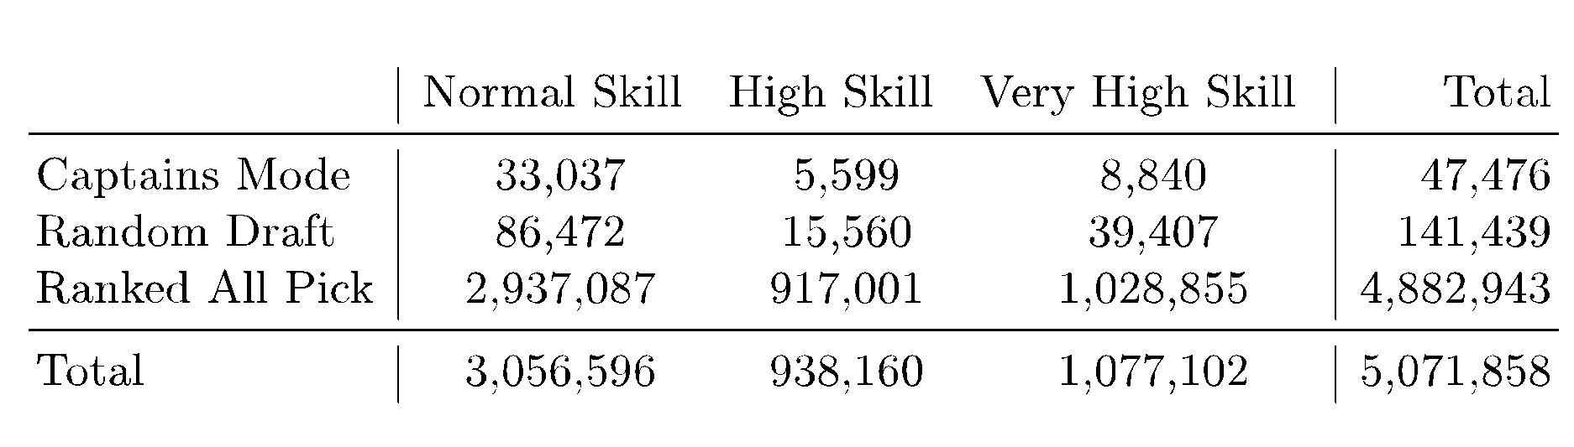
Draft stage win prediction
Input data
Match = 5 heroes for each team out of 113
Target: win or lose? Whose pick is better?

Slide 7


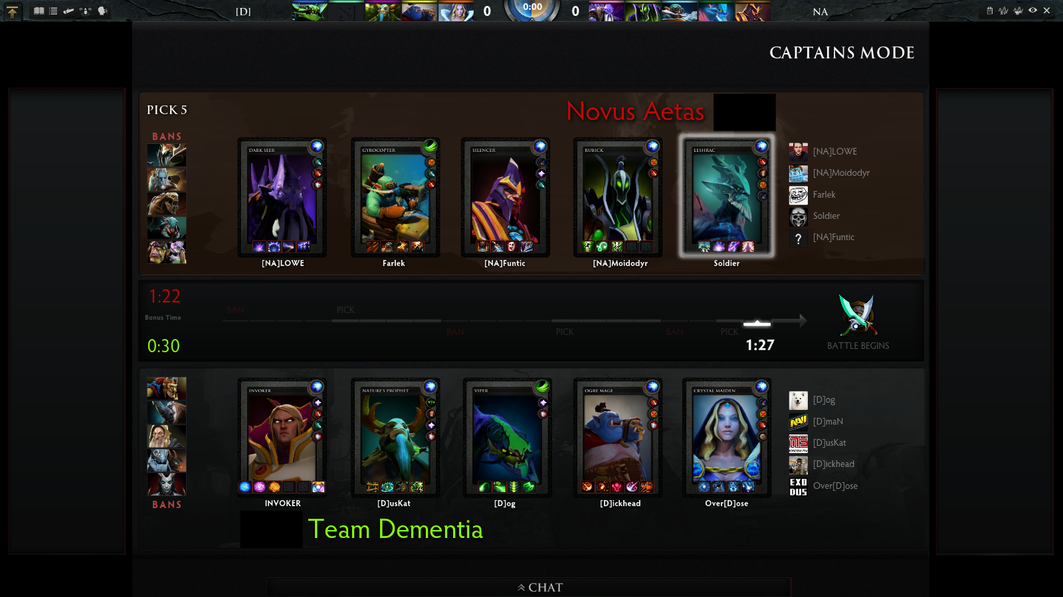
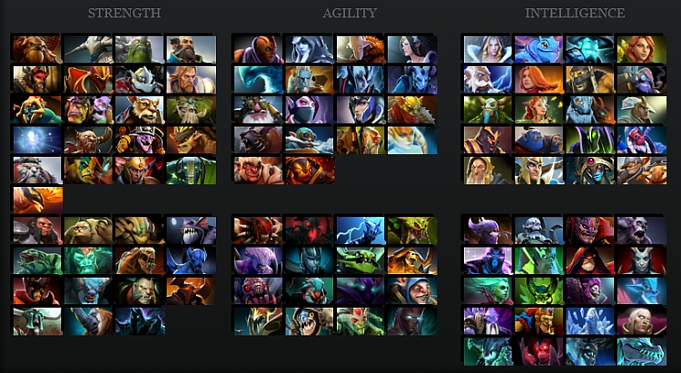
Big variety of matches
What is different in matches:
Players and their strategies
Picked heroes.
Total amount of combinations
Matches played since 2013
Each player choose one hero
113 heroes pool

Slide 8
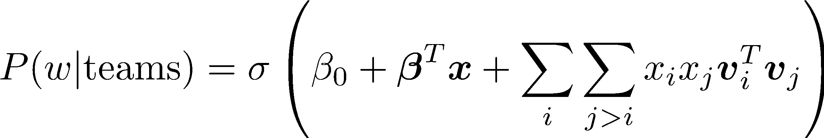
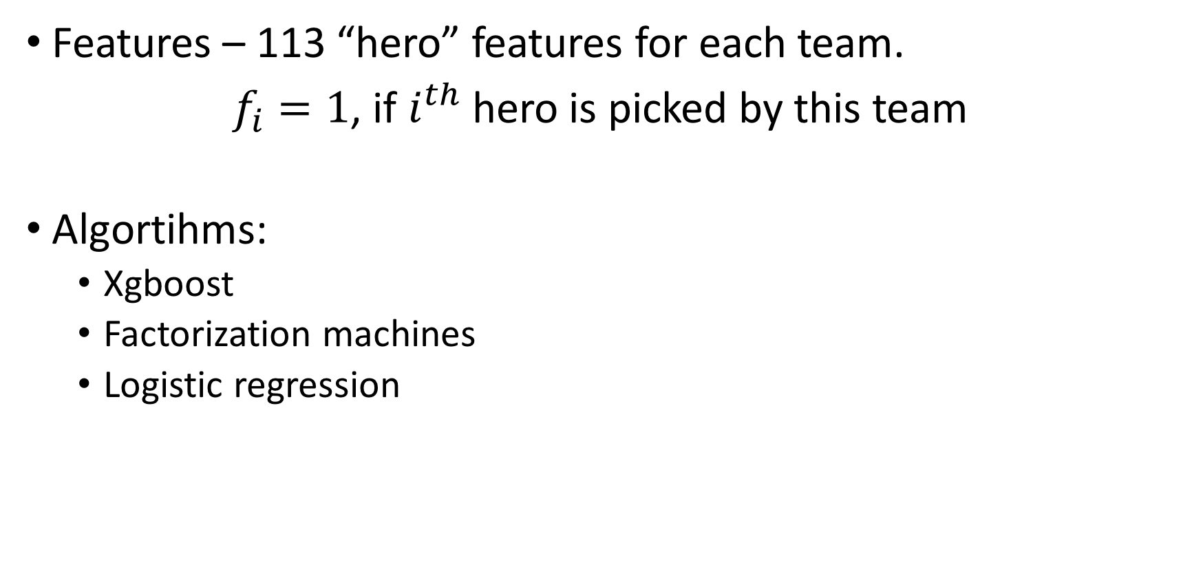
Algorithms
Features – 113 “hero” features for each team.
$f_{i}=1$, if $i^{th}$ hero is picked by this team
Algortihms:
Xgboost
Factorization machines
Logistic regression
2nd order factorization model

Slide 9
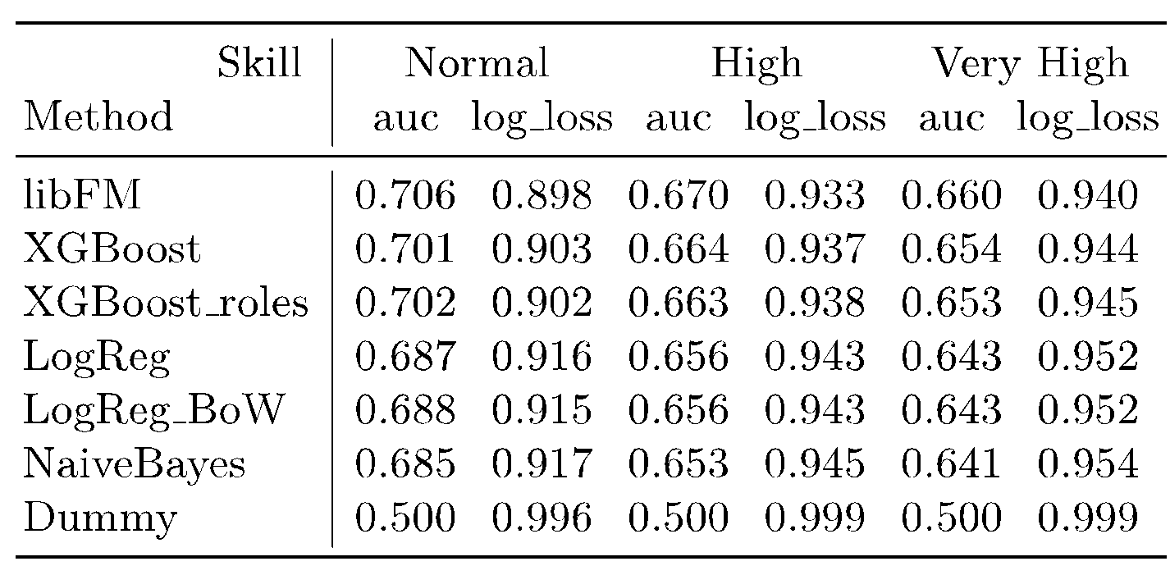
Results
Set of picked heroes explains at least
6% of information(Shannon) for very high skill players
10% of information for normal skill

Slide 10
YASP dataset
Timeseries of heroes features (points every 30s) such as:
Gold
Experience
Items (purchasing)
Abilities
heroes trajectories (coordinates on map)
Special buildings(such as tower) states (destroyed or not)

Slide 11
Task:
Predict winner using first 5 minutes of match
Data:
≈120 000 preprocessed matches
Final task for ML course as Kaggle In-class сompetition
One of the most popular kaggle in-class contest:
650 solo competitors (teams were not allowed)
A lot of different ideas, special features
Very good feedback

Slide 12
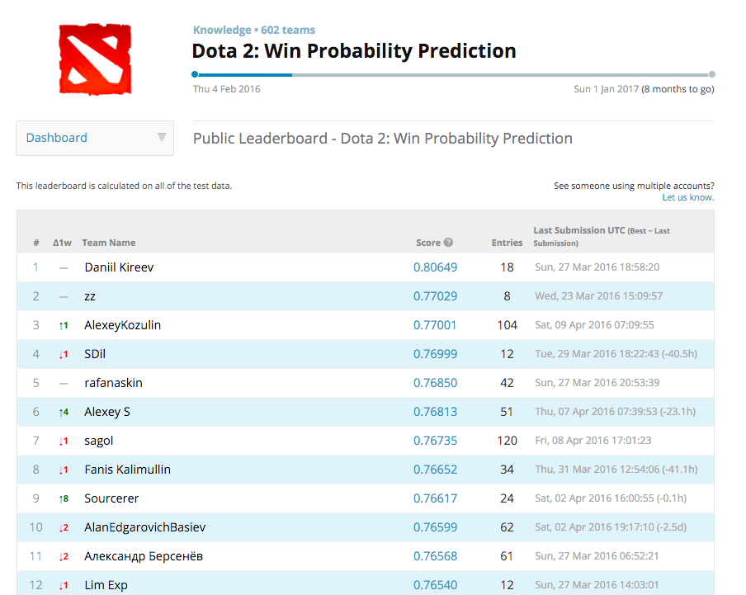
Winner’s solution
Use Logistic Regression instead of more complex models (e.g. Random Forest, GBDT)
Find good informative features
Statistics for each team
One-hot encoded picked heroes in the teams
First time team used some items (bottle, courier, ward)
Often combinations of heroes in the team: pairs and triples (need to be accurately selected, easy to overfit)
Aggregated hero characteristics

Slide 13
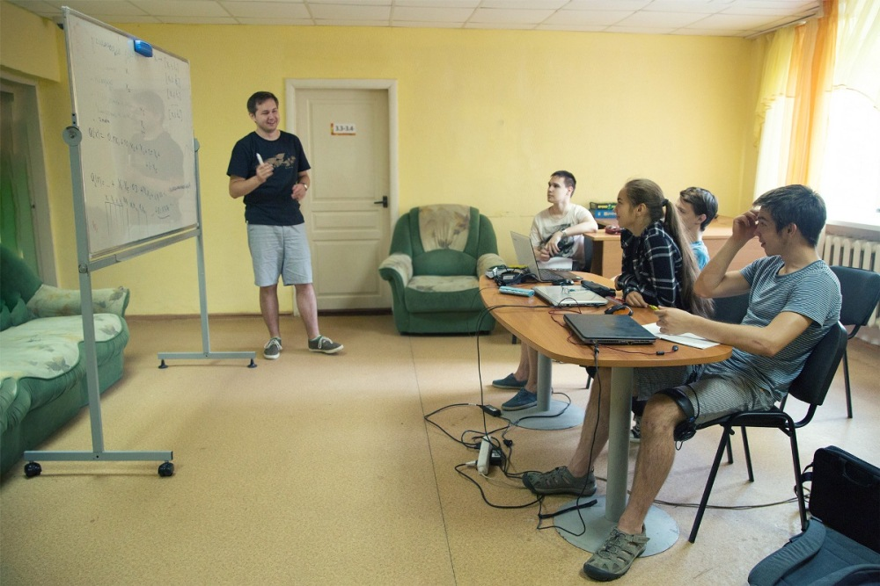
Notes:
My colleague explains basics of ML on the example of dota 2 competition to pupils

Slide 14
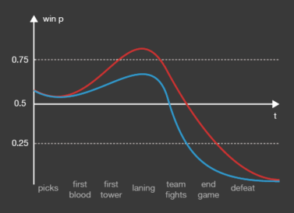
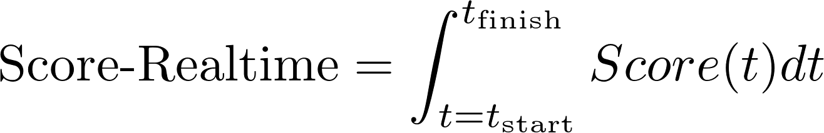
Realtime win prediction
https://github.com/romovpa/dotascience-hackathon

Slide 15
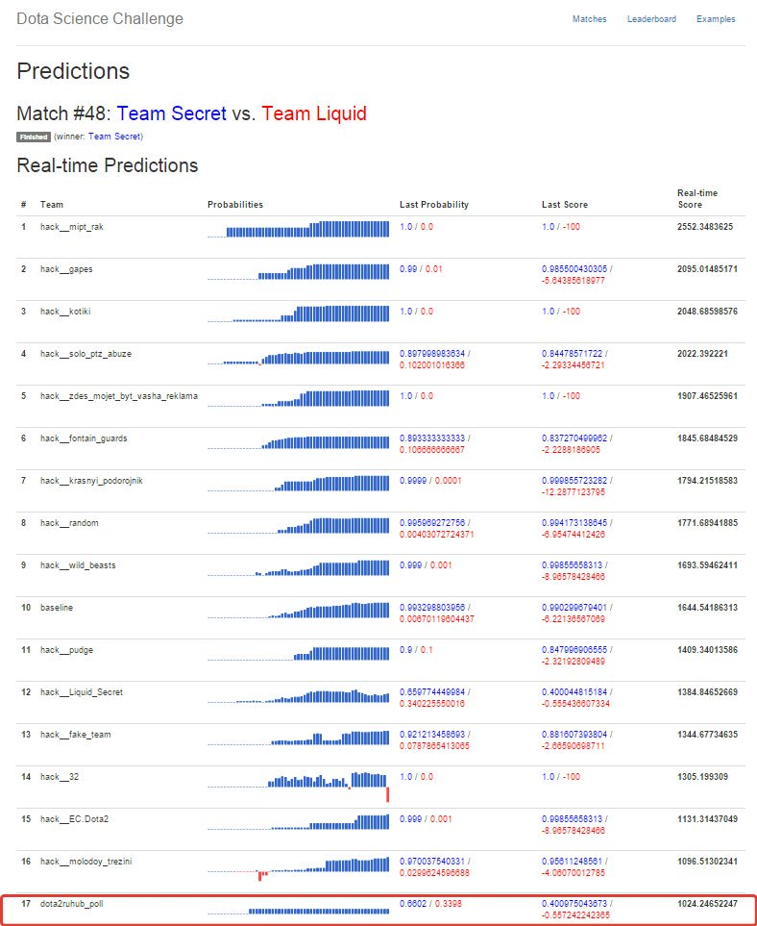
Hackathon:
Realtime leaderboard during Shanghai Major
35 teams competed
Usage of external data
External data:
odds parsed from websites
Additional data from steam API
Parsed replays
Notes:
During

Slide 16
Summary
Large dataset of Dota2 matches
Game outcome prediction using drafts stage
auc = 0.66 – 0.7 (depending on skill)
Kaggle In-class contest: win prediciton having first 5 minutes
auc = 0.8
Dota Science hackathon – realtime win prediction
baseline quality practically doubled

